Slide 2
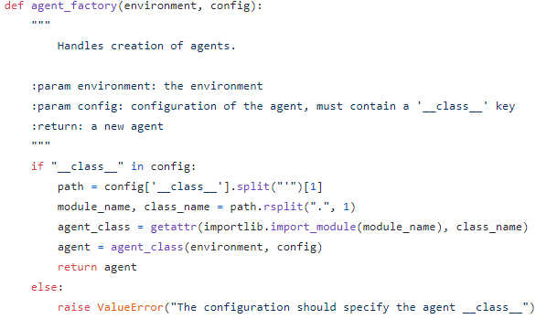
factory.py
[INFO] Loaded DQNAgent model from out/HighwayEnv/DQNAgent/saved_models/latest.tar
INFO: Creating monitor directory out/HighwayEnv/DQNAgent/run_20210523-061342_58

